Slide 1
COVID Deaths & Societal Factors in US – Executive Presentation
Date: April 17, 2021
Presenter: Elizabeth Miller

Slide 2
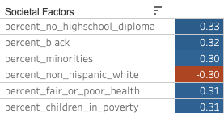
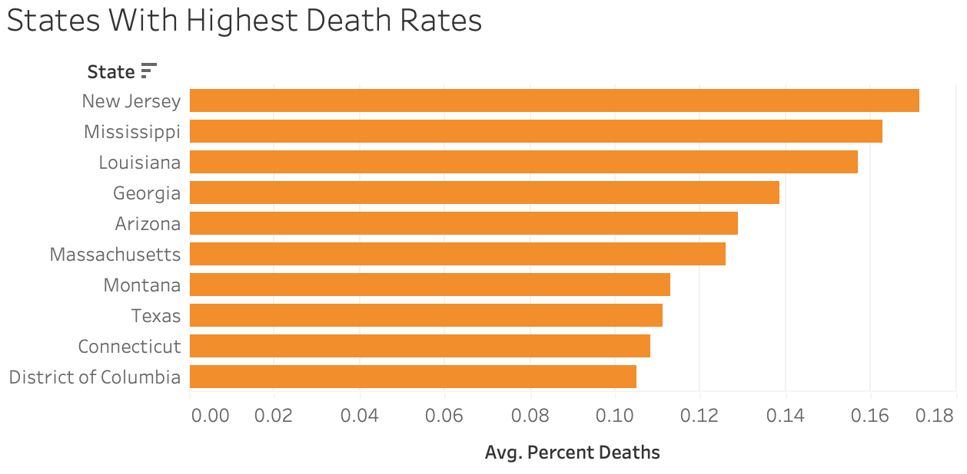

Executive Summary: Which societal factors correlate with COVID death rate in US counties and have value in predicting the geographical areas where most help is needed?
Coefficient of correlation
with COVID death rate*
Percent population of the following correlated most strongly with COVID death rate ¹:
Without a high school diploma
Black American
Fair or poor health status
Children in poverty
Non-Hispanic white (negative correlation)
Reduce COVID deaths by increasing vaccination rate to the national average by Q3 end
²
Prioritize vaccine delivery to vulnerable counties
Partner with community leaders in education to defuse mistrust³
Use more federal resources per capita to help address inequality that caused vulnerability⁴
¹ https://bit.ly/3mKbdoo, https://bit.ly/3wYWc71
² Latest date COVID data collected: 12/4/2020
³ https://bit.ly/3agLTBj
⁴ https://brook.gs/3acuhqs, https://bit.ly/3x89YnZ
*Percent of population that died from COVID

Slide 3
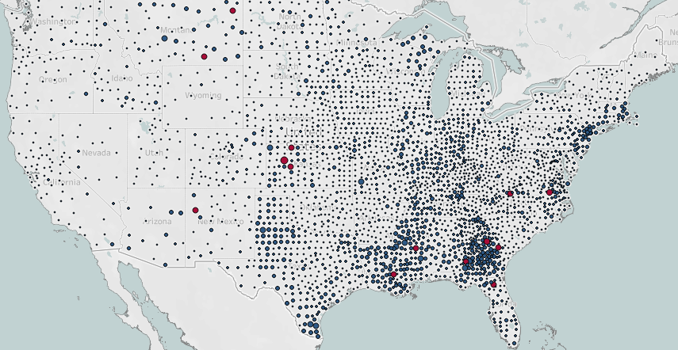
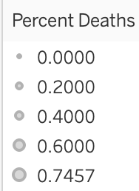
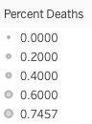
The southern US contains many of the counties with both highest COVID death rates and populations facing at-risk factors.
Percent deaths from COVID 0.37% or more
Percent deaths from COVID in US counties^{2,3}
Over half of counties with COVID death rate of 0.37% or higher, shown in red, are in the south region.
Map for AK, HI: https://tabsoft.co/3dYTbuA

Slide 4
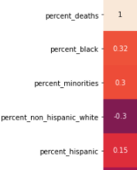
Among the categories of societal factors examined, the racial percentages of counties account for three of the five strongest predictors of COVID death rate.
Correlation with COVID death rate
Coefficient
Percent Black population links relatively strongly with COVID death rate.
Percent minorities follows close behind.
Counties with higher percentage white residents have a tendency toward lower COVID death rates.
Percent Black accounts for most of the percent minorities correlation:​
Percent Latinx (Hispanic) makeup of counties is shown to correlate with COVID death rate at a mild 0.15; other races at almost 0.
Sources: https://bit.ly/3mKbdoo, https://bit.ly/3wYWc71

Slide 5
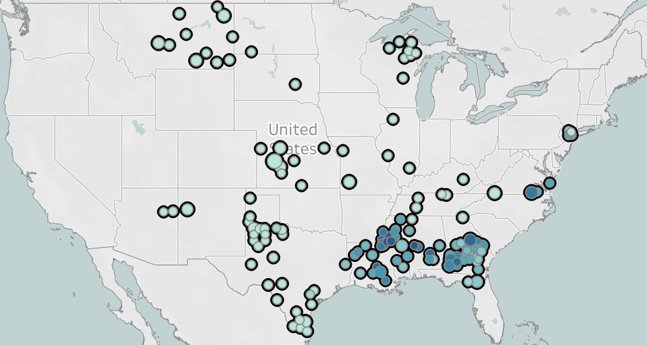
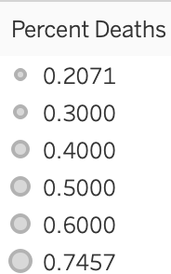
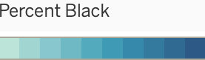
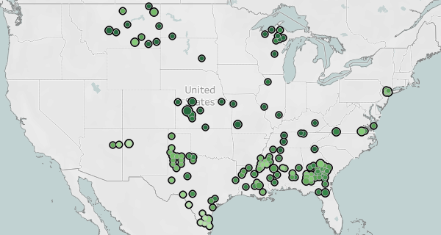

Structural racism persists: many counties with comparatively high COVID death rates have higher Black populations and lower white ones.¹
Maps are filtered for COVID death rate of 0.2% or more.²
Many counties with high death rates also are high percent Black.
Most counties in upper range of COVID death rate are low percent white (south region)
Some southwest counties are also low percent white. They are high percent Latinx.
0%. 80%
Address racial disparity
Deploy mobile vaccination units to vulnerable areas
Train medical providers to treat all equitably²
3%. 98%
¹ https://bit.ly/3mKbdoo , https://bit.ly/3wYWc71
² Additional maps for this project: https://tabsoft.co/3dYTbuA
³https://www.commonwealthfund.org/publications/newsletter-article/2021/jan/medical-mistrust-among-black-americans

Slide 6
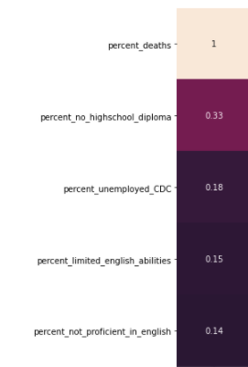
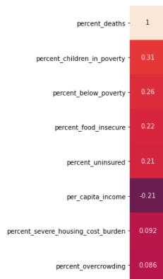
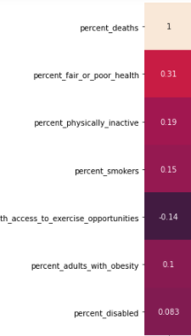
Factors related to education, income, and health status also rank as strong predictors of death rate due to COVID.¹
Percent population with no high school diploma showed the strongest correlation with US county COVID death rates.
Many income-related county population variables correlated with COVID death rate,² especially children in poverty.
Health status showed strong correlation as well.
Prioritize counties high in these risk factors for vaccines and related education.
Correlation with COVID death rate
Correlation with COVID death rate
Correlation with COVID death rate
Coefficient
Coefficient
Coefficient
¹ https://bit.ly/3mKbdoo , https://bit.ly/3wYWc71
²Measures above the note-worthy correlation coefficient parameter of 0.2 as defined by Chris Hui, Springboard course founder

Slide 7
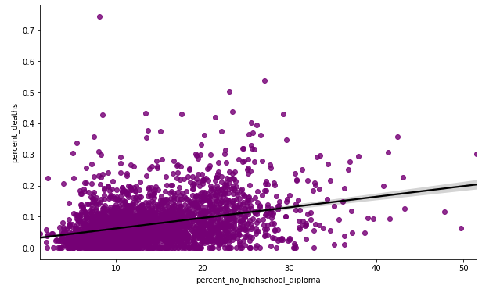
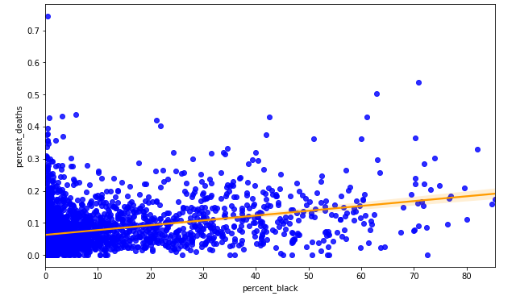
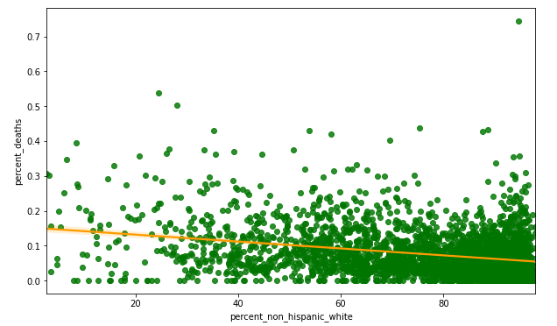
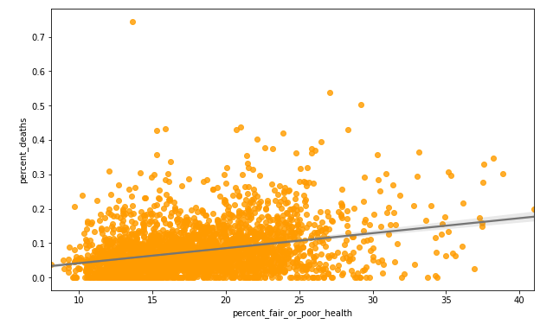
The strongest predictors of COVID death rate in US counties relate to education, race, and health status.
Each plot shows variables correlating most strongly with COVID death rate in counties:
percent no high school diploma (purple)
percent Black (blue)
percent white (green)
percent fair or poor health (orange)
These are the significant factors the data tells us to think about.

Slide 8
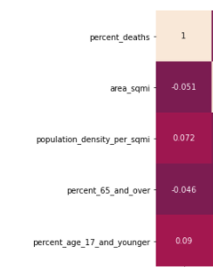
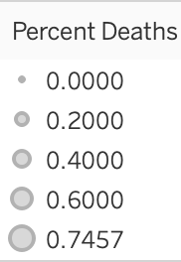
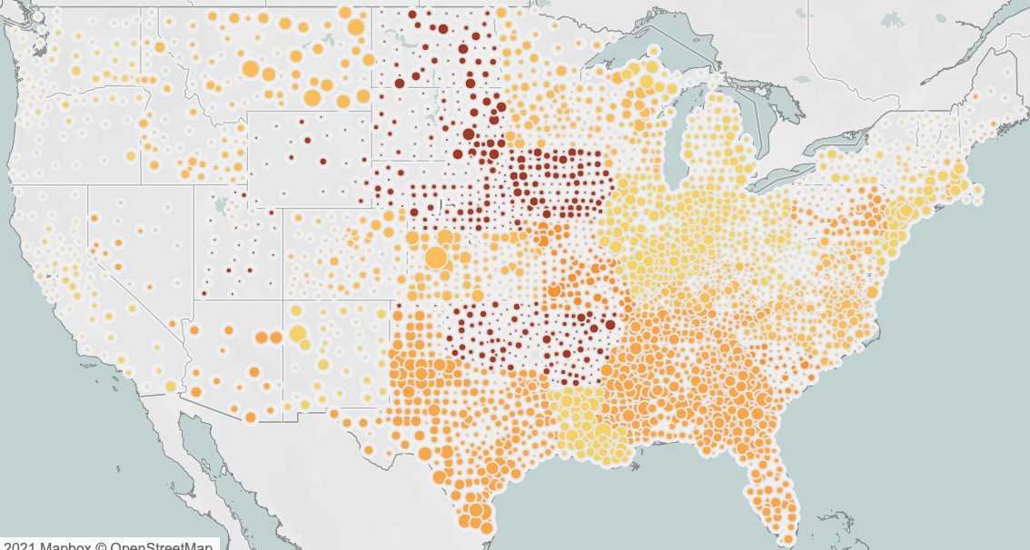
Societal factors in US counties not linked to COVID death rate: percent over age 65, population density. Timing of stay-at-home order shows small relationship.
Correlation with COVID death rate
Coefficient
Stay-at-home order date by county
Stay at home start: days after 3/17/20
0-7
7-14
14-21
No order
Population density did not link to COVID death rate.
Later stay at home orders and higher death rates linked weakly at a 0.15 correlation coefficient.
Later orders correlated strongly with percent Black (0.34) and negatively with percent white (-0.24).
Correlation with COVID death rate
 | Coefficient
Later order | 0.15
Correlation with later orders
 | Coefficient
perc_black | 0.34
perc_white | -0.24
Address racial disparity
Raise government commitments to saving Black lives: prioritize vaccines and related education delivery.
Stay at home order information: https://ephtracking.cdc.gov/DataExplorer/

Slide 9
Recommendations
Risk Profile
Counties with higher percentage populations of the following tend to be more vulnerable to COVID death:
Without a high school diploma
Black American
Children in poverty
In fair or poor health
The US south region holds many, though not all, counties with one or more aspects of this risk profile.
(For more maps, see https://tabsoft.co/3dYTbuA)
States historically invested the longest in slavery made fewer public good expenditures.
Inequalities persist today, impacting those less access to healthcare and education, as well as Black, and low-income populations.¹
Recommendations with focus on US south first
Deliver vaccines and concentrated educational programs to defuse mistrust and misinformation
Use federal resources such as National Guard to meet people where they are
In medical settings²:
Empathy training for providers toward all races
Clinician/ patient conversations sharing personal stories about medical treatment
Asking patients their preferences
Giving refunds in response to a bad experience
¹ McGhee, Heather. _The Sum of Us: What Racism Costs Everyone and How We Can Prosper Together.
²_https://www.commonwealthfund.org/publications/newsletter-article/2021/jan/medical-mistrust-among-black-americans

Slide 10
Sources
Links to sources
The dataset
https://www.kaggle.com/johnjdavisiv/us-counties-covid19-weather-sociohealth-data
CDC COVID death by county
https://www.cdc.gov/nchs/covid19/covid-19-mortality-data-files.htm
CDC stay-at-home order information
https://ephtracking.cdc.gov/DataExplorer/
New York Times COVID case and death counts
https://github.com/nytimes/covid-19-data
Kaiser Family Foundation (stay at home orders)
https://www.kff.org/policy-watch/stay-at-home-orders-to-fight-covid19/
County Health Rankings
https://www.countyhealthrankings.org/
Poor education predicts poor health
https://nam.edu/poor-education-predicts-poor-health-a-challenge-unmet-by-american-medicine/
Interventions to reduce educational inequalities and improve health
https://archpublichealth.biomedcentral.com/articles/10.1186/s13690-020-00402-5
Relationship between Black/white wealth gap and COVID
https://www.brookings.edu/blog/up-front/2020/12/08/the-black-white-wealth-gap-left-black-households-more-vulnerable/

Slide 11
Sources, continued
Lower income areas have less revenue for education
https://www.future-ed.org/state-education-funding-concentration-matters/
Suggested interventions for the demonstrated poorer medical treatment received by Black Americans
https://www.commonwealthfund.org/publications/newsletter-article/2021/jan/medical-mistrust-among-black-americans
Black Americans are undertreated for pain
https://pubmed.ncbi.nlm.nih.gov/22239747/
Southern (“red”) states have comparatively low vaccination rates
https://apnews.com/article/joe-biden-donald-trump-alabama-georgia-savannah-941ef2bf9b60ee39d6b9fd5e2ce861f7
McGhee, Heather. _The Sum of Us: What Racism Costs Everyone and How We Can Prosper Together._
Kaiser Family Foundation: uninsured statistics
https://www.kff.org/uninsured/issue-brief/key-facts-about-the-uninsured-population/
Pew Research 63% of US thinks there should be one government program that provides health care coverage
https://www.pewresearch.org/fact-tank/2020/09/29/increasing-share-of-americans-favor-a-single-government-program-to-provide-health-care-coverage/
Population density has not been connected to COVID death rate
https://www.scientificamerican.com/article/population-density-does-not-doom-cities-to-pandemic-dangers/
https://www.huffpost.com/entry/covid-19-population-density-myth_n_5ff8c68fc5b63642b6fba9eb

